Slide 1
Object Oriented Programming using Java (ECSE102L)

Slide 2
Outline
Lifecycle of an Object
Wrapper Classes

Slide 3
Lifecycle of an Object
S
There are four parts in lifecycle of an Object:
  Object creation
  Object accessing
  Object not accessing
  Garbage collection

Slide 4
Lifecycle of an Object (Cont…)
S
There are four parts in lifecycle of an Object (Cont…):
  Object creation:
  We create an object by using new keyword.
  We can initialize reference variable with the object.
  public class Creation
  {
  public static void main (string args[])
  {
  Creation abc= new Creation();
  }
  }

Slide 5
Lifecycle of an Object (Cont…)
S
There are four parts in lifecycle of an Object (Cont…):
  Object accessing:
  When we create an object, we can access it.
  We can access it, till the statements/conditions are true.
  If we reassign another object to an initialized reference variable, the previous object becomes inaccessible.

Slide 6
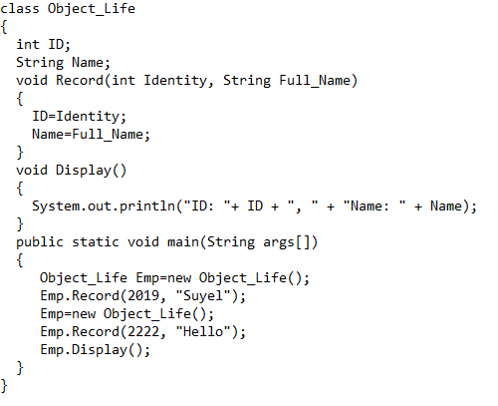
Lifecycle of an Object (Cont…)
S
There are four parts in lifecycle of an Object (Cont…):
  Object accessing (Cont…):

Slide 7
Lifecycle of an Object (Cont…)
S
There are four parts in lifecycle of an Object (Cont…):
  Object accessing (Cont…):
    Output:
      ID: 2222, Name: Hello

Slide 8
Lifecycle of an Object (Cont…)
S
There are four parts in lifecycle of an Object (Cont…):
  Object not accessing:
  An object become inaccessible, if it goes out of scope.
  Then, the object is no longer be referenced and compiler makes garbage collection for the object.

Slide 9
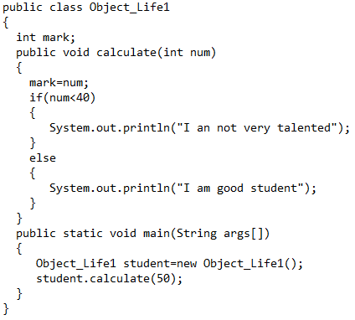
Lifecycle of an Object (Cont…)
S
There are four parts in lifecycle of an Object (Cont…):
  Object not accessing:

Slide 10
Lifecycle of an Object (Cont…)
S
There are four parts in lifecycle of an Object (Cont…):
  Garbage collection:
  It is a process by which Java programs perform automatic memory management.
  Java programs converts to bytecode that can be run on a JVM.
  Objects are created on the heap (a portion of memory) dedicated to the program.
  If any object is not needed in future, the garbage collector finds these unused objects and deletes them.

Slide 11
Lifecycle of an Object (Cont…)
S
There are four parts in lifecycle of an Object (Cont…):
  Garbage collection (Cont…):
  Unreachable objects: An object has become unreachable, if it doesn’t contain any reference to it.
  Object_Life Emp=new Object_Life();
  Emp.Record(2019, "Suyel");
  Emp=null;

Slide 12
Wrapper Classes
S
A wrapper class is a class whose object wraps or contains a primitive data types.
Wrapper classes provide a way to use primitive data types (int, boolean, etc..) as objects.
When we create an object to a wrapper class, it contains a field. In this field, we can store a primitive data types.
All the wrapper classes in java are immutable.

Slide 13
Wrapper Classes (Cont…)
S
Need of Wrapper Classes
  We need object, when we want to change the arguments passed into a method (call by value). Wrapper classes convert primitive data types into objects.
  To support synchronization with objects in Multithreading.
  Java collection framework (ArrayList, LinkedList, PriorityQueue, etc.) works with objects only.

Slide 14
Wrapper Classes (Cont…)
S
The eight classes of the java.lang package are known as wrapper classes in Java.
Primitive | Wrapper Class
boolean | Boolean
char | Character
byte | Byte
short | Short
int | Integer
long | Long
float | Float
double | Double

Slide 15
Wrapper Classes (Cont…)
S
Main methods wrapper classes:
  valueOf() method:
    We can use valueOf() method to create wrapper object for given primitive or string.
    It is a static method.
    It returns object reference of relative wrapper class.
    public class Method
    {
    public static void main (String args[])
    {
    Interger hello=Integer.valueOf(“123”);
    Double hello1=Double.valueOf(“3.14”);
    Interger hello2=Integer.valueOf(“1010”, 2);
    }
    }

Slide 16
Wrapper Classes (Cont…)
S
Main methods wrapper classes (Cont…):
  parseXxx() method:
    It is also a static method.
    Xxx can be replaced by any primitive type.
    It returns Xxx type value.
    public class Method
    {
    public static void main (String args[])
    {
    int I=Integer.parseInt(“123”);
    double d=Double.parseDouble(“3.14”);
    }
    }

Slide 17
Wrapper Classes (Cont…)
S
Main methods wrapper classes (Cont…):
  xxxValue() method:
    Instance method of wrapper class.
    Xxx can be replaced by any primitive type.
    It returns xxx primitive type.
    public class Method
    {
    public static void main (String args[])
    {
    Interger hello1=Integer.valueOf(“1010”, 2);
    int a= hello1.intValue()
    }
    }

Slide 18
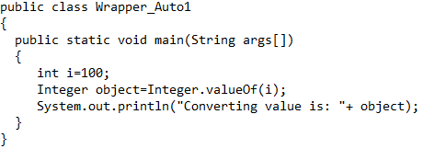
Wrapper Classes (Cont…)
S
Autoboxing:
  Converting primitive data type to wrapper type.

Slide 19
Wrapper Classes (Cont…)
S
Autoboxing (Cont…):
  Output
  Converting value is: 100

Slide 20
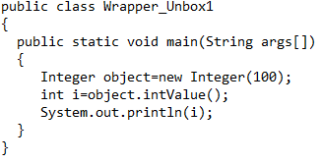
Wrapper Classes (Cont…)
S
Unboxing:
  Converting wrapper type to respective primitive data type.
  It is the reverse process of autoboxing

Slide 21
Wrapper Classes (Cont…)
S
Unboxing (Cont…):
  Output
  100

Slide 22
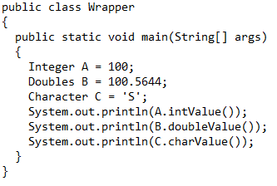
Wrapper Classes (Cont…)
S

Slide 23
Wrapper Classes (Cont…)
S
Unboxing (Cont…):
  Output
  100
  100.5644
  S

Slide 24




